Slide 1
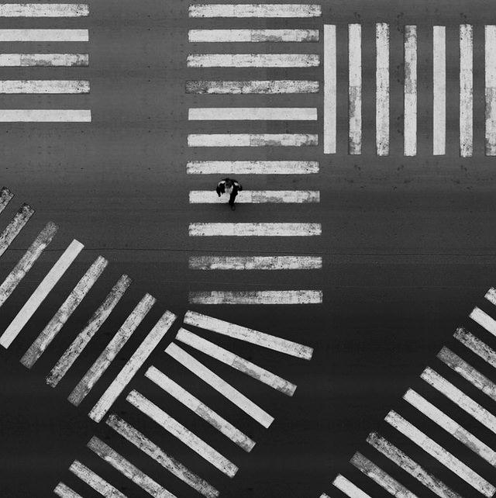
Carme Garau, arquitecta col.laboradora

Slide 2
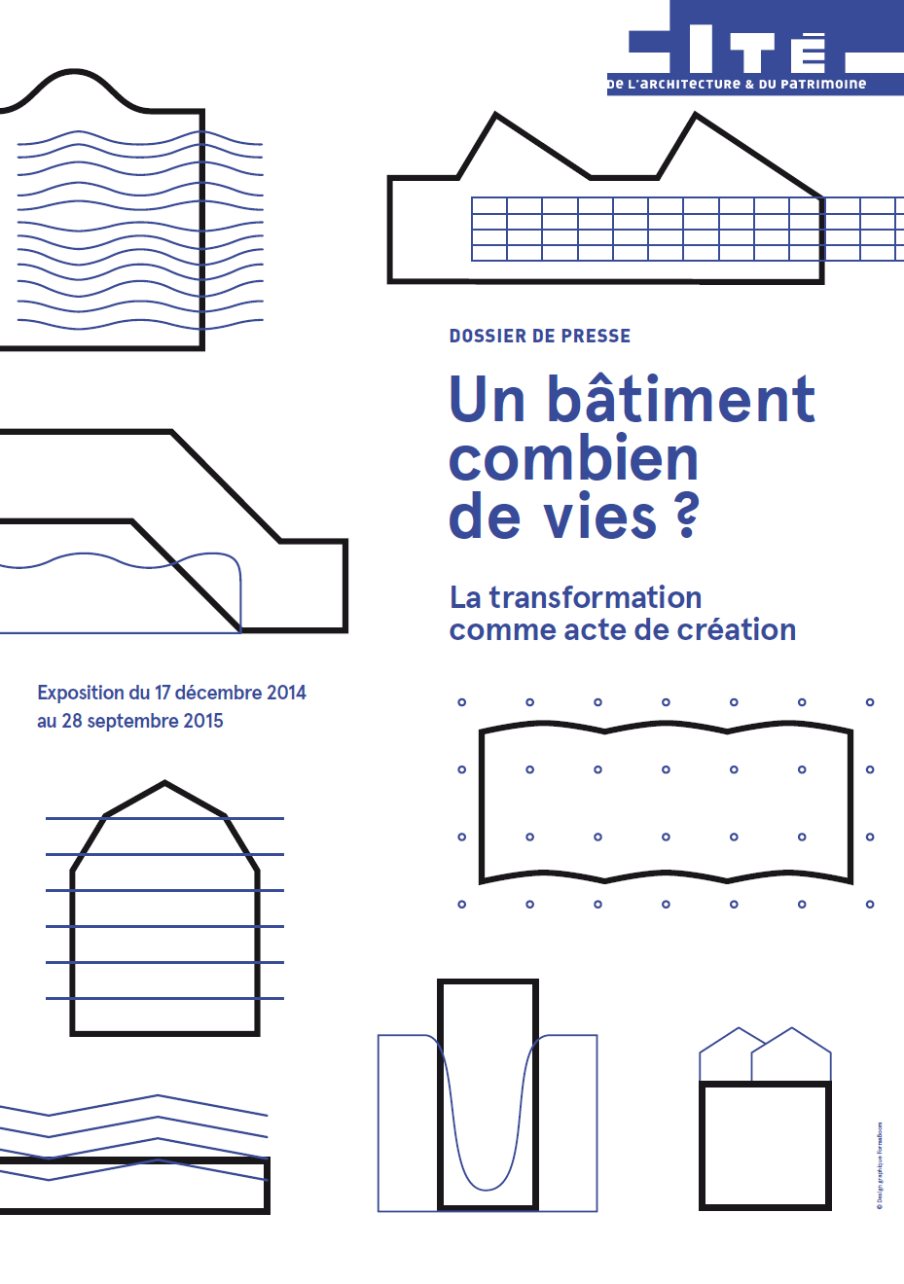
Un bâtiment, combien de vies? La transformation comme acte de création
Un bâtiment, Combien de vies ? La transformation comme acte de création Une exposition, trois phases, trois tables rondes, trois approches
mercredi 4 février 2015 de 15h à 19h : Approche théorique, 'Transformation versus conservation' lundi 16 mars 2015 de 14h30 à 19h : Approche technique, 'Transformer c’est expérimenter' mardi 2 juin 2015 de 14h30 à 19h : Approche économique, 'Transformation versus démolition'

Slide 3
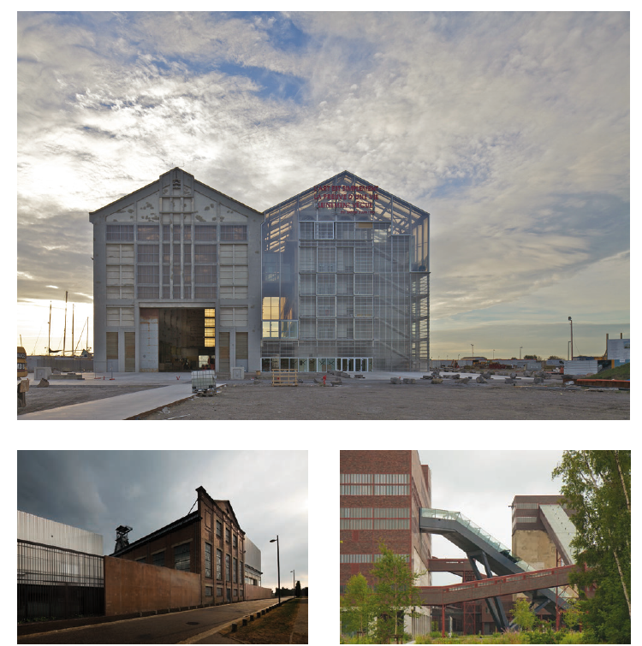
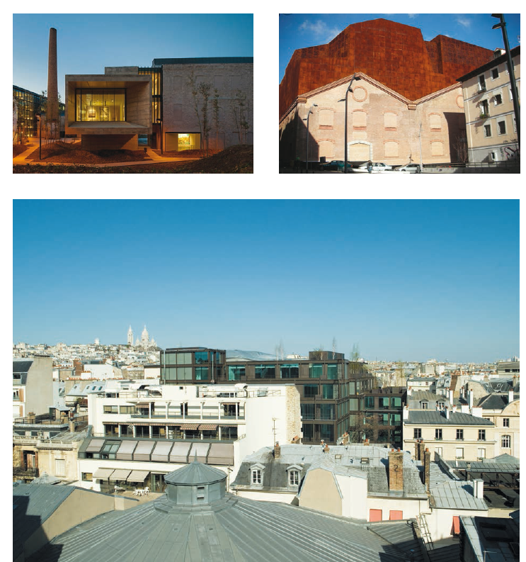
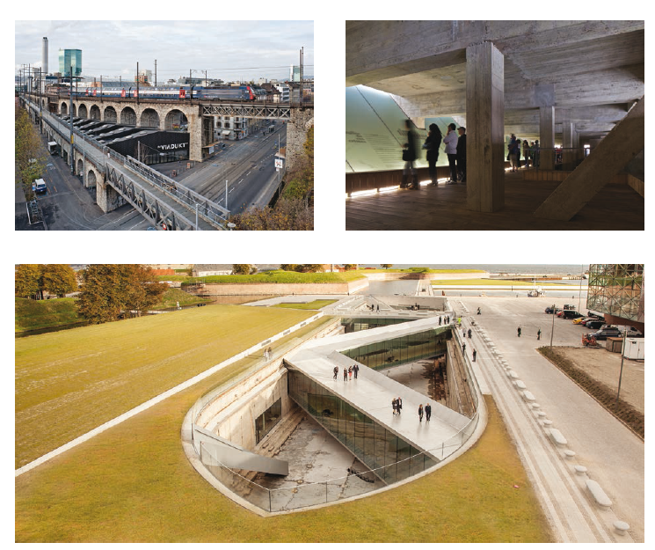

Slide 4
THE EUROPAN 13 TOPIC CONTINUES WITH THE EUROPAN 12 TOPIC ON "THE ADAPTABLE CITY" AND ENRICHES ITSELF WITH THE VISIONS OF 40 EUROPEAN EXPERTS…
To read the detailed E13 Topic text + Experts lectures, click here
It is proposed for Europan 13 to continue with the generic theme of "the adaptable city": adaption to the need for more sustainable development but adaption also to the context of an economic crisis that the majority of European cities are currently undergoing. Three generic concepts structure this overall theme:
Resilience as a challenge: to be able to extend or find again the identity of the city’s structural elements (built or landscaped) in a context of significant changes.
Social adaptability as a goal: reconciling the coherence of these structures with the evolving uses and practices.
Economy as a method: managing urban transformations in different contexts of actors and means, yet with limited resources and in the era of the “post-oil city”
Taking these three themes into account induces changes in the urban and architectural order:
in the logics of actors – Welfare State Vs. Self-Organization The essence of the European city is a certain sense of the community. A change is currently taking place from less “welfare state” to more “self organization”. What will the new relation between the public and private domains be? Who will take care of the public domain if the state is less involved? And what does it mean for the practice as architects or urban planners?
in the contents – Segregation Vs. Sharing Sharing at the urban scale can stimulate the "empowerment" of coexistences between different cultures: preserving the collective while inventing a more appropriate organization of the society. How could sharing be a way to develop cheaper and lighter solutions to build an ecological and sustainable city? How could it be a way to regenerate the co-inhabited environments?
in the design processes – Object Vs. Project (Process) With communication tools and social networks in the rising, our culture grows less object-based; and this phenomena affects architecture and urbanism. Many young architects are emerging though the implementation of projects presenting less physical objects, yet where the scope of the projects is as important as the objects involved. The objects can already partly exist and the project is about managing the existing, dealing with social constructions, developing a context and raising the question of “urbanism with less or without growth”.
Europan therefore wishes that the sites be confronted to the major challenges concerning the adaptability of European cities and also propose concrete innovations in the order given by the site representatives, arousing new project approaches by young competitors.
2015 Europan 13:
The Adaptable City 2
Self-Organization –
Sharing – Project
(Process)

Slide 5
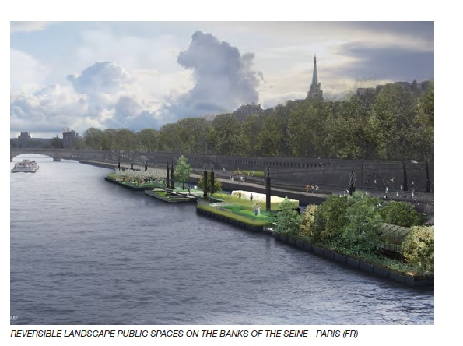

Slide 6
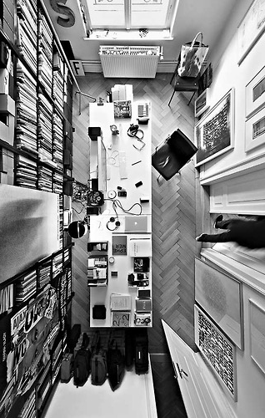
OBJETIVOS DEL CURSO
EXPERIMENTACIÓN DE NUEVAS FORMAS PARA LOS PROGRAMAS COMPLEJOS ‘MIXEDFORMS’
PROYECTAR ESPACIOS DE HABITABILIDAD ENTORNO A LAS INFRAESTRUCTURAS,
CREAR NUEVOS PAISAJES MEDIANTE LA FUSIÓN DE LOS PRINCIPIOS DEL ‘LANDSCAPE DESIGN’ Y EL ‘LANDSCAPE URBANISM’
EXPLORAR SOBRE FORMAS Y ESTRUCTURAS DE ESPACIOS ARQUITECTÓNICOS DE LA CIUDAD TRIDIMENSIONAL,
PROYECTAR PROFUNDIZANDO EN LAS NUEVAS TÉCNICAS CONSTRUCTIVAS, ESTRUCTURALES, INFRAESTRUCTURALES
EXPLORAR SOBRE LAS DISTINTAS ESTRATEGIAS PARA EL RECICLAJE URBANO DE LA CIUDAD EXISTENTE,
USAR LA REPROGRAMACIÓN COMO POSTURA DE CONCRECIÓN DE LA ARQUITECTURA CONTEMPORÁNEA,
EXPLORAR LOS OPERADORES PROYECTUALES QUE NOS PERMITEN AFRONTAR LA MATERIALIZACIÓN DE NUEVOS ESPACIOS COMPLEJOS
FORMULAR LA PERTINENCIA DE UN TRABAJO DISCIPLINAR PROPIO
FUNDAMENTAR NUESTRO TRABAJO SOBRE EL PRINCIPIO DE “ACTUAR LOCAL - PENSAR GLOBAL”
FACILITAR TÈCNIQUES I EINES DE PROJECTACIÓ

Slide 7
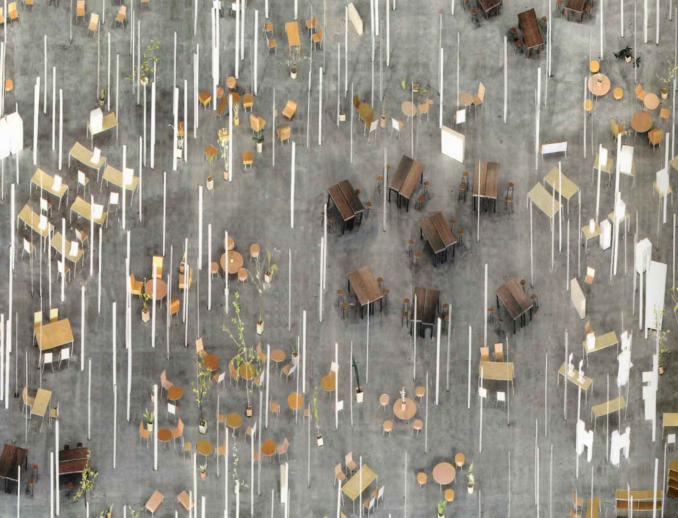
METODOLOGIA
ATLAS
CARTOGRAFIAS_MAPAS_DIAGRAMAS
A cloud is one new image for architecture.
To conceive a building as if planning a forest.
Another scale of archiecture. JUNYA ISHIGAMI

Slide 8
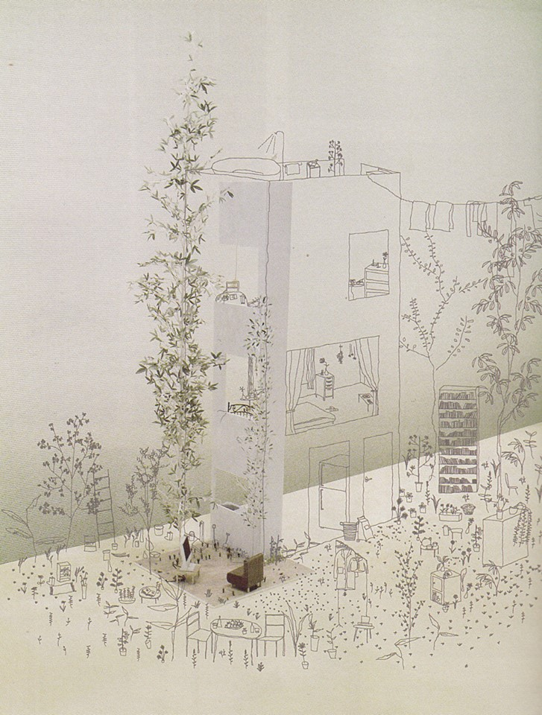
TIC_TEMA IMATGES CONCEPTE
REALITAT_RECREACIÓ
LLOC_TOPOS
PROGRAMA_PROJECTE
LÍMIT
DENSITAT_INTENSITAT_DIVERSITAT
ESCALA_TAMANY
MIXED USE
MÈTODE_INSPIRACIÓ
INTEGRAR LES INFRASTRUCTURES
STANDARITZACIÓ_ARTESANIA
REGENERACIÓ_REPROGRAMACIÓ
REPRESENTACIÓ
Architecture and the city are not separate things, but are different manifestations of a single thing.
Futurospective Architecture SOU FUJIMOTO

Slide 9
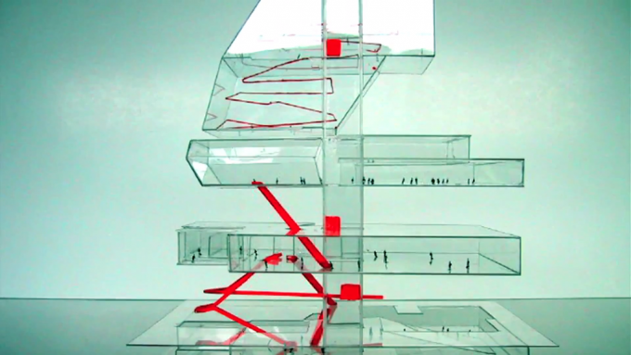
SETEMEBRE 2015
S1 7 9 PRESENTACIÓ DE CURS
S2 14 16 ORGANITZACIÓ CURS, GRUPS, PRESENTACIÓ DETALLADA DEL CURS I TREBALL
S3 21 23 TIC 1 / VISITA DELS LLOCS
S4 28 30 EXERCICI 1/2/3
OCTUBRE 2015
S5 5 7 LLIURAMENTS I CORRECCIONS Exercicis 1/2/3
S6 12 14 TIC 2/ CORRECCIONS
S7 19 21 TIC 3/ CORRECCIONS
S8 26 28 TIC 4/ CORRECCIONS
NOVEMBRE 2015
S9 2 4 TIC 5 / CORRECCIONS
S9 9 11 TIC 6 / CORRECCIONS
S10 16 18 LLIURAMENTS I CORRECCIONS P1
S11 23 25 TIC 7 / CORRECCIONS
S12 30 2 TIC 8 / CORRECCIONS
DESEMBRE 2015
S13 7 9 LLIURAMENTS I CORRECCIONS P2
S14 14 16 CORRECCIONS
S15 21 23 CORRECCIONS
GENER 2015
SJ 11 13 PRESENTACIÓ FINAL JURY

Slide 10
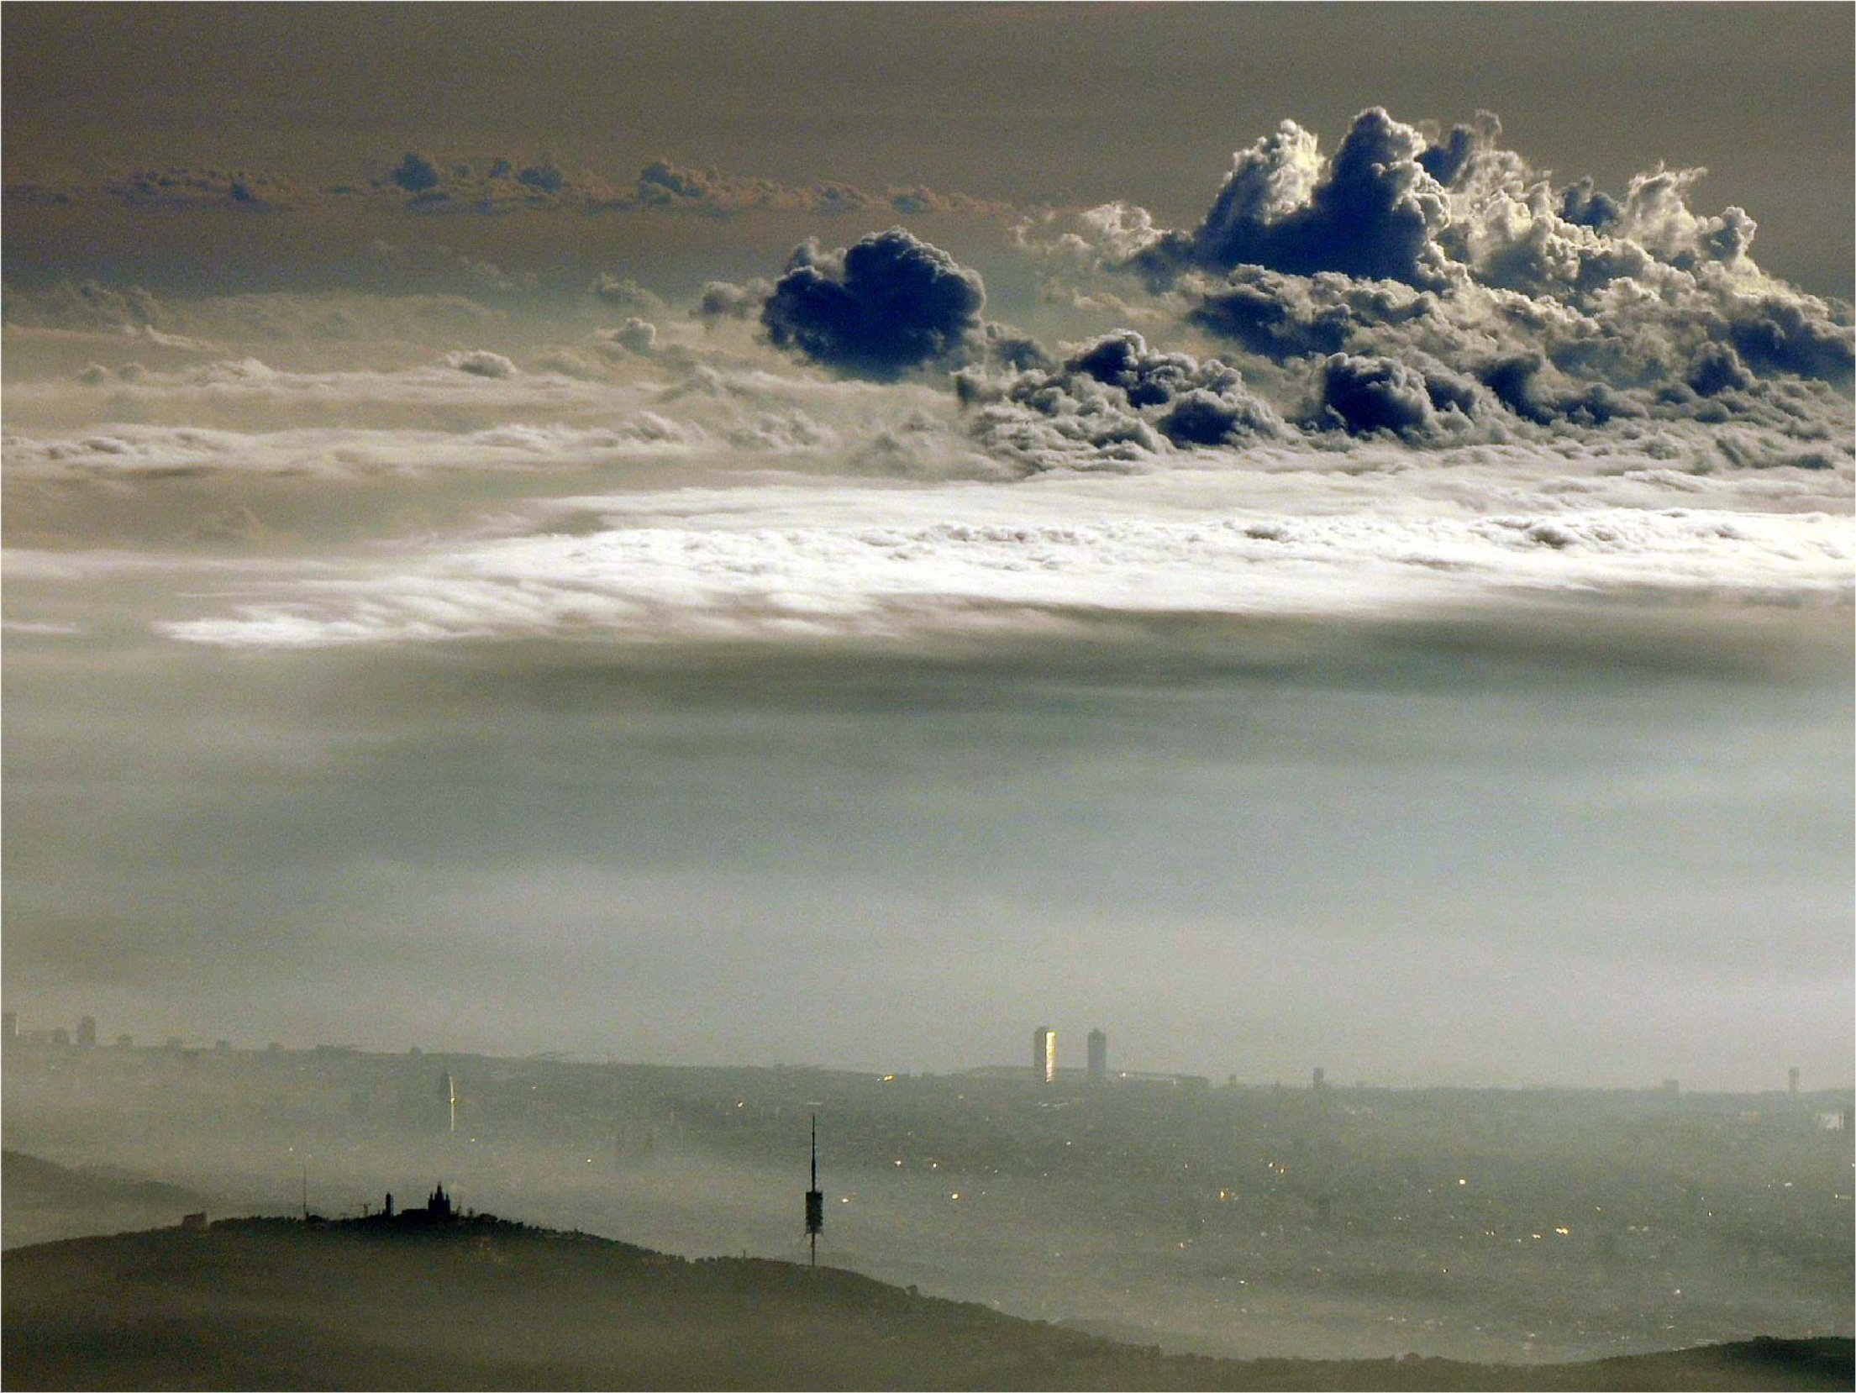

Slide 11
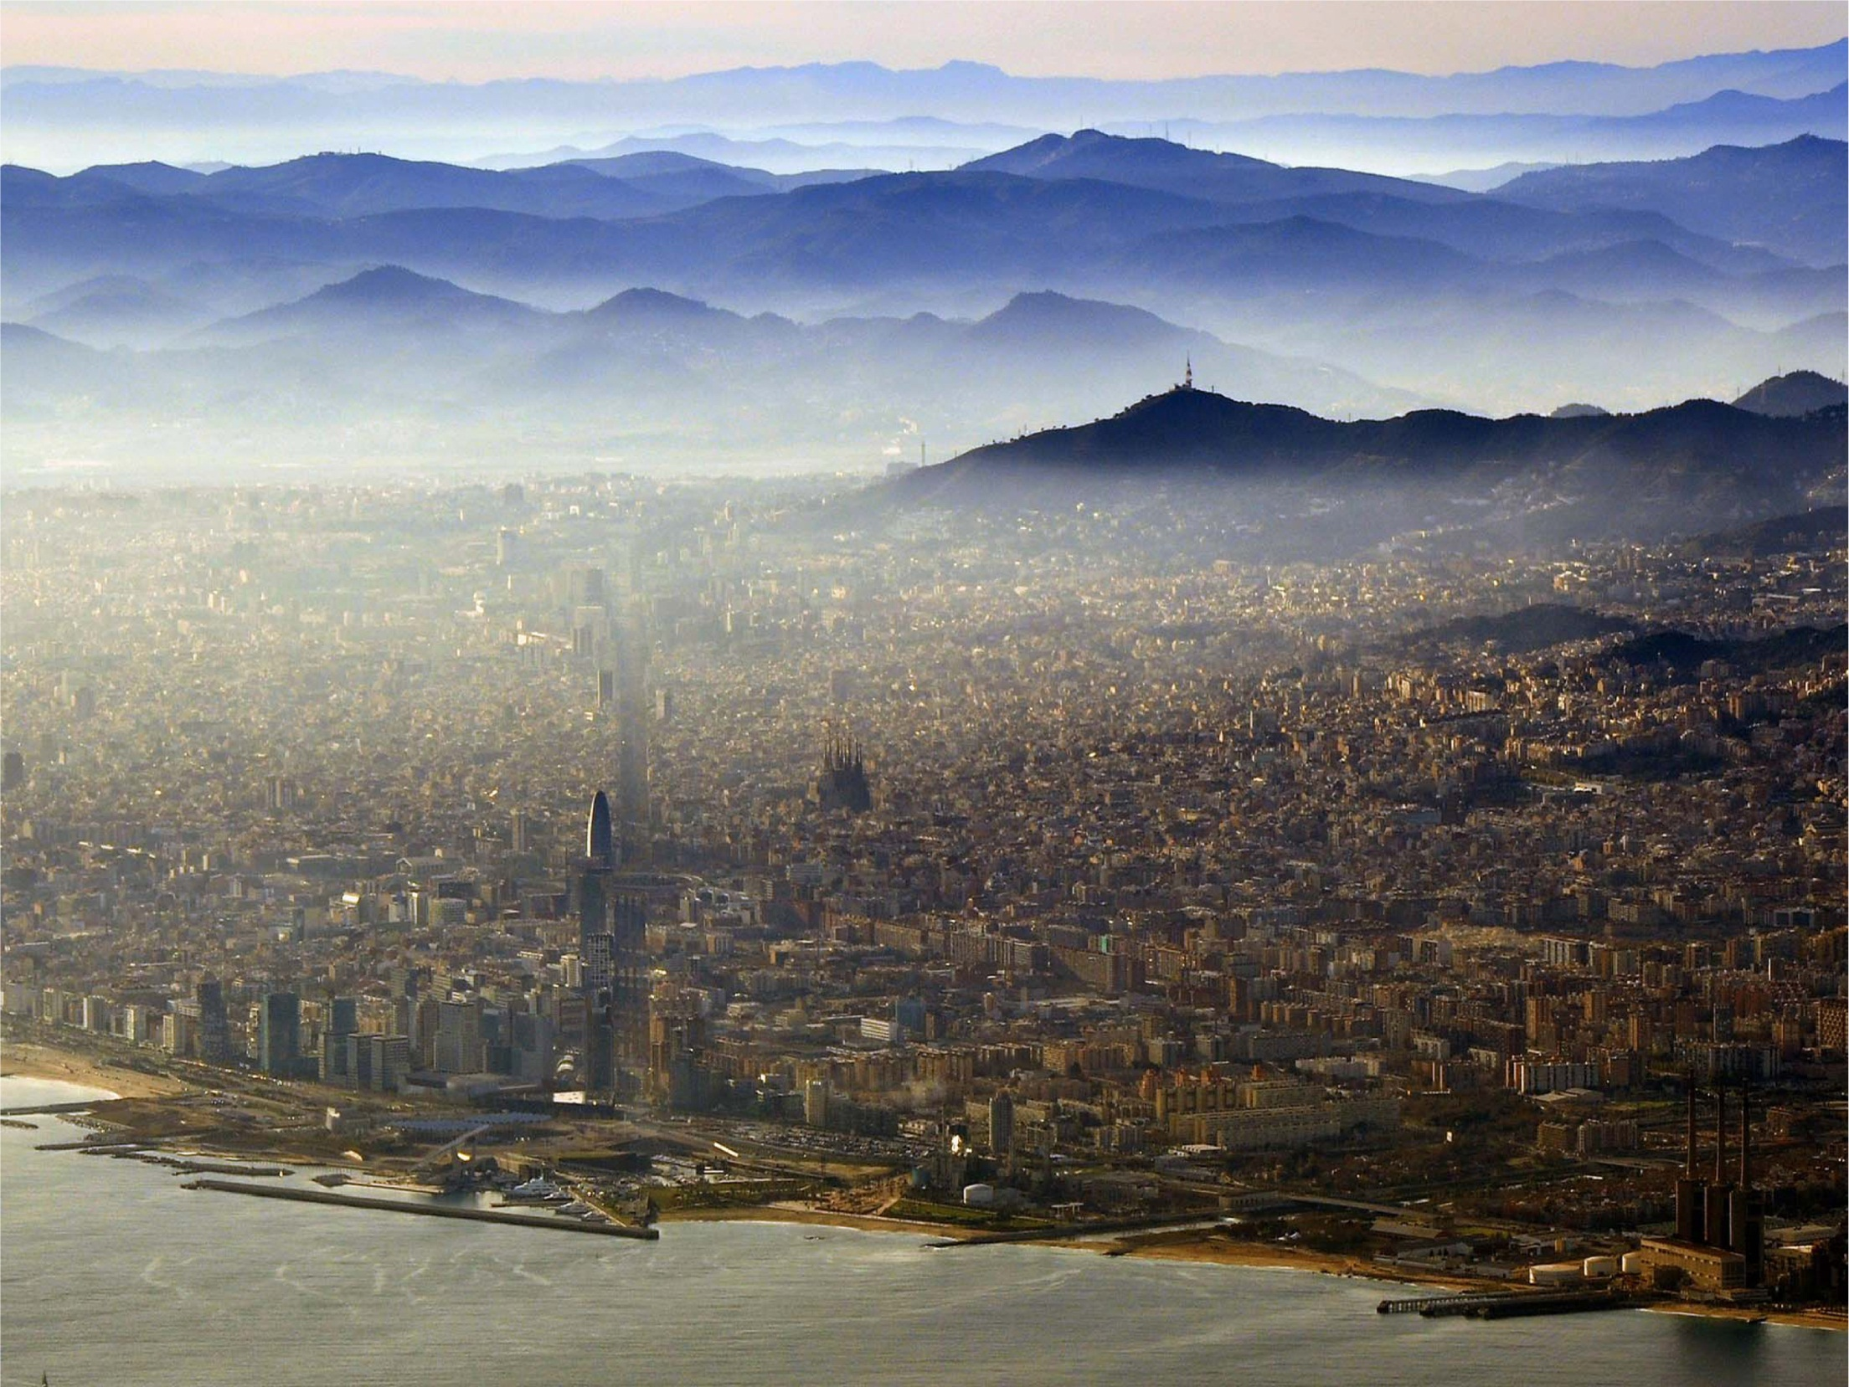

Slide 12
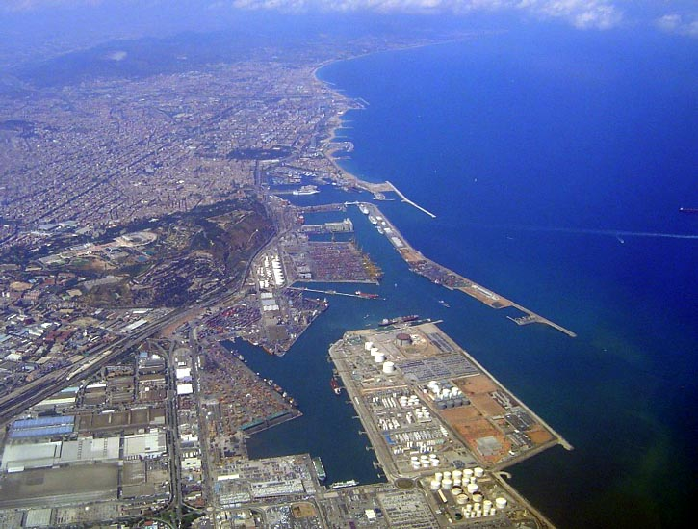

Slide 13
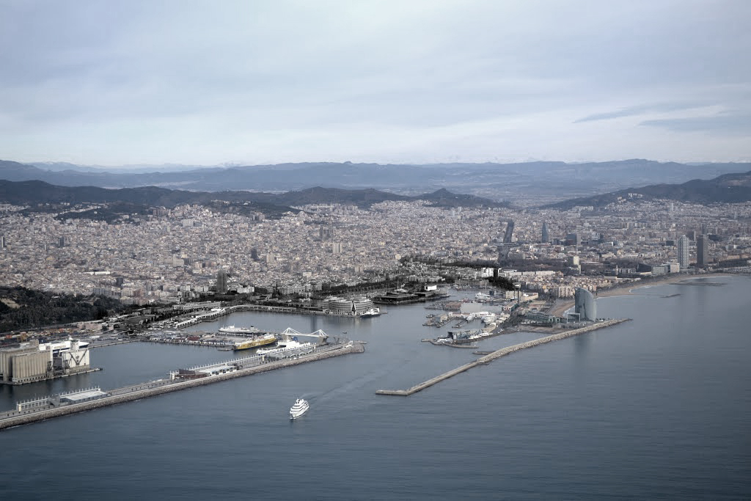
Barcelona 2015

Slide 14
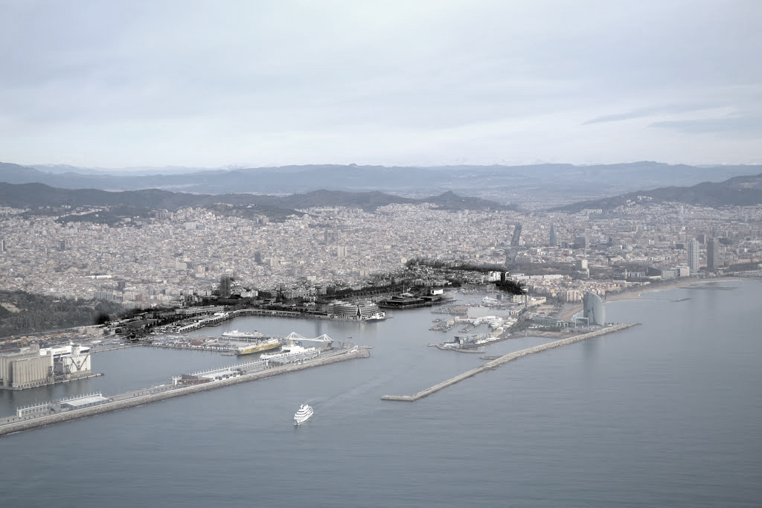
Museu de Ciències Naturals
Palau de Justícia
Museu d’Història de Catalunya
Delegació del Govern
Comandància Militar
Estació de França
Capitania General
Escola de Nàutica
Drassanes
Correus
Duana
Llotja
Barcelona 2015

Slide 15
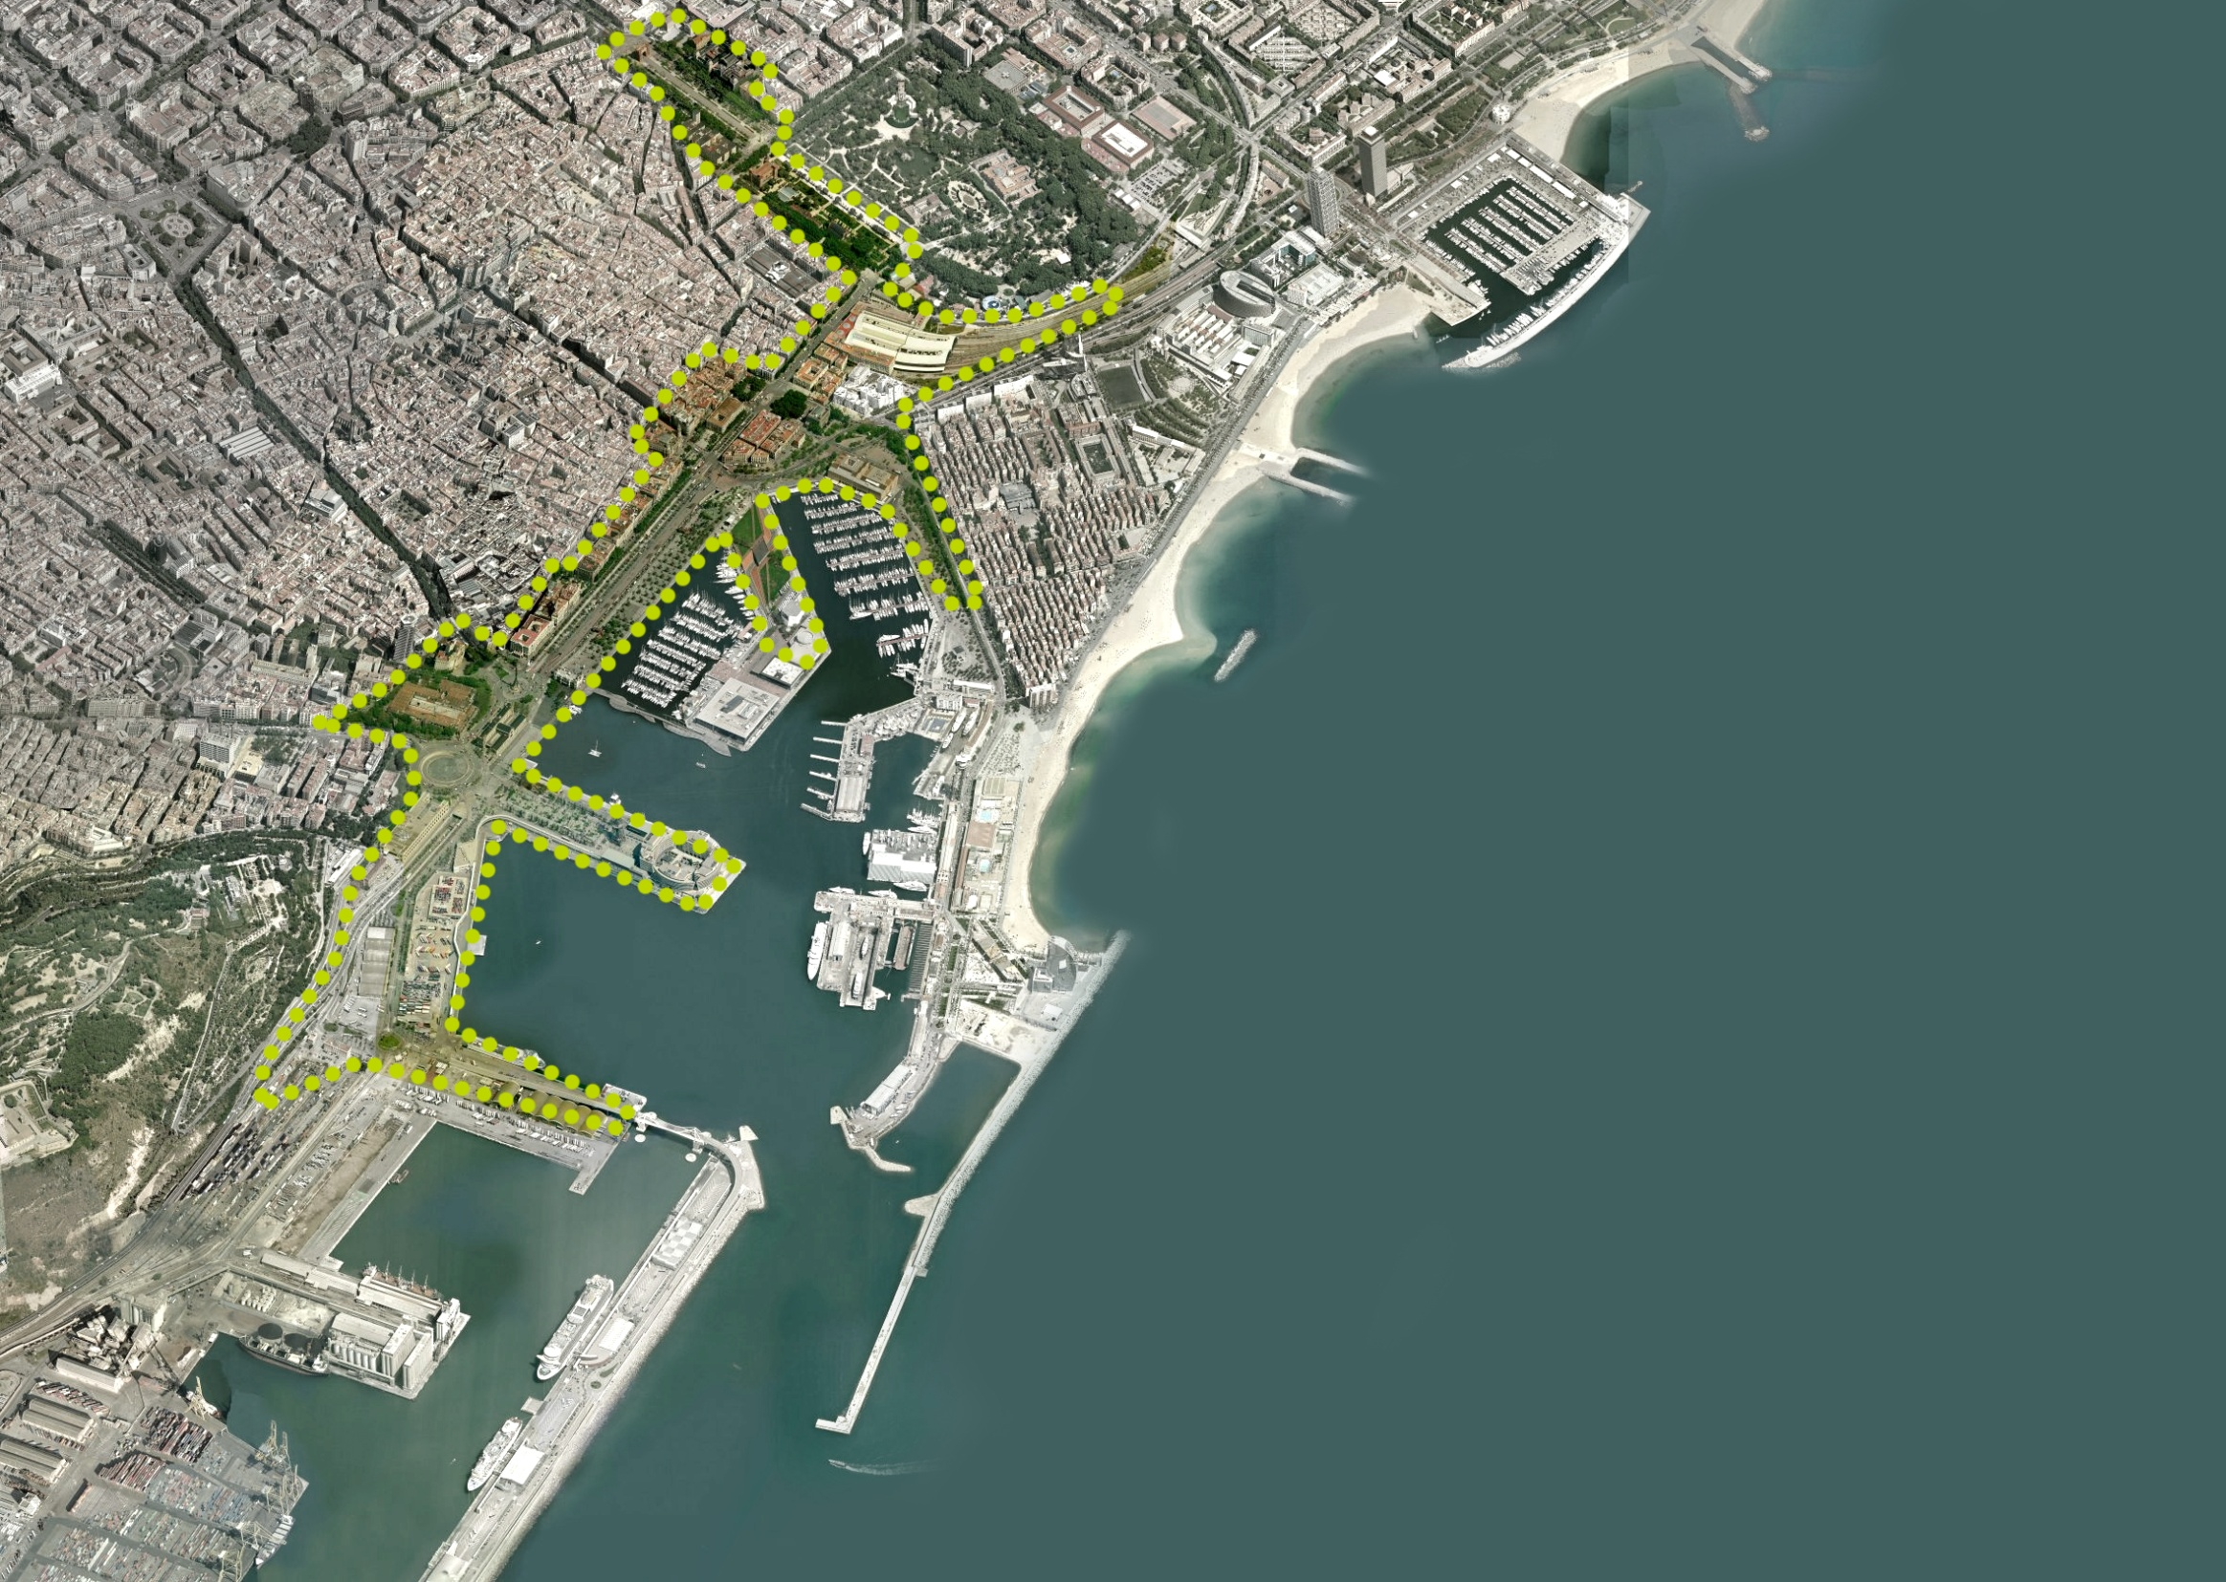
Un metaparc metropolità
Una via verda i de mobilitat
Tramvia
People mower
Arquitectures d’equipament
Carrers transversals
Eixos civics
Vies verdes
Places
Centres de barri
Nous eco barris
Peces nodes de ciutat
Barcelona 2015

Slide 16
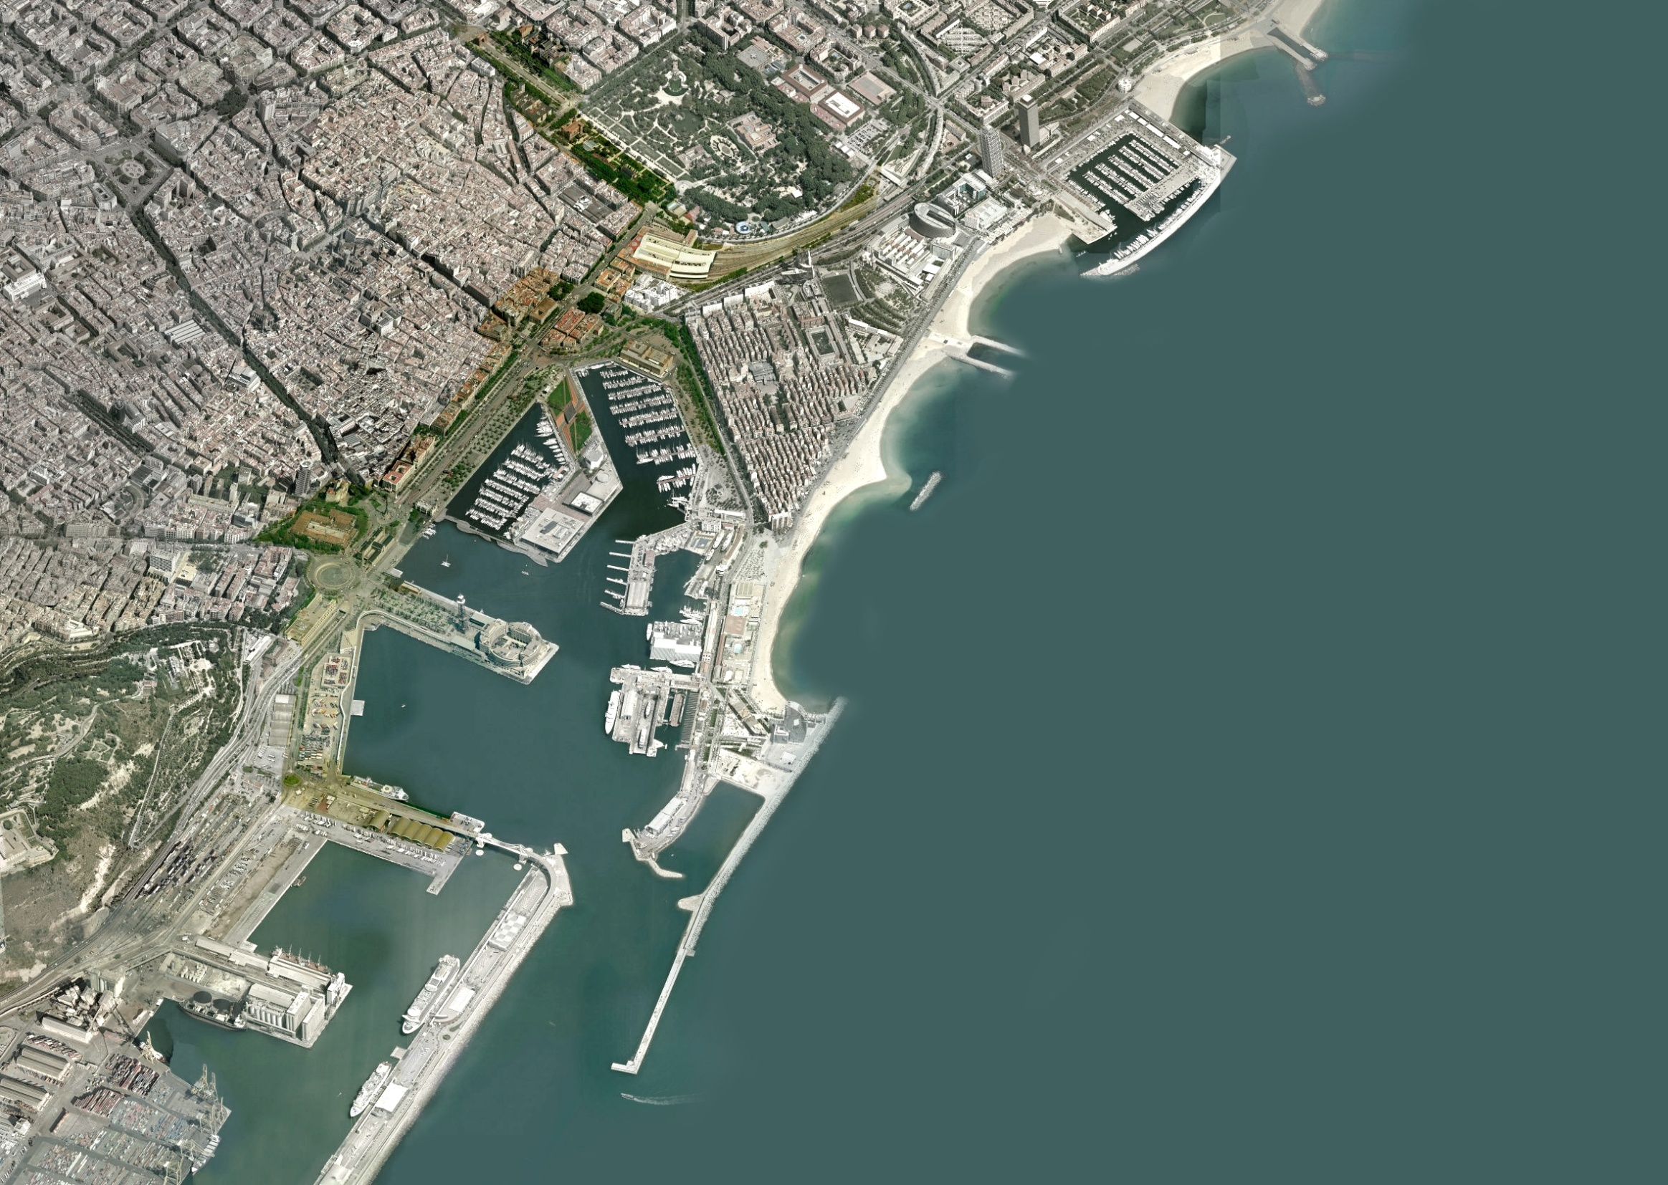
Palau de Justícia
Museu de Ciències Naturals
Hivernacle
Umbracle
Delegació del Govern
Llotja
Estació de França
Correus
Escola de Nàutica
Capitania General
Museu d’Història de Catalunya
Comandància Militar
Drassanes
Duana
Barcelona 2015

Slide 17
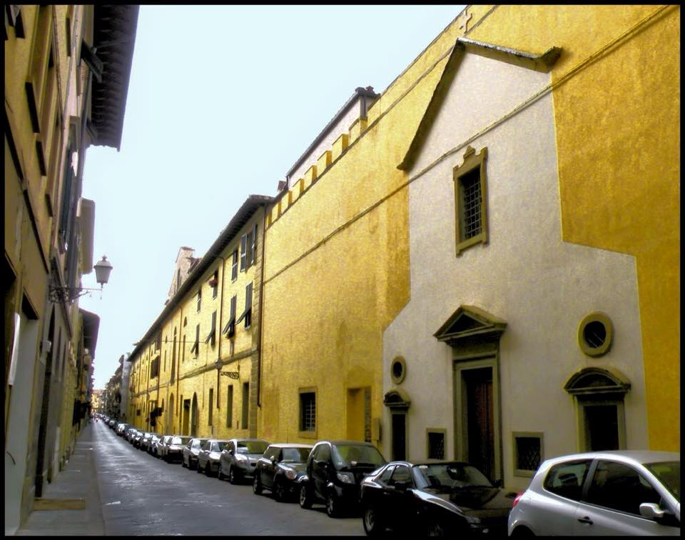
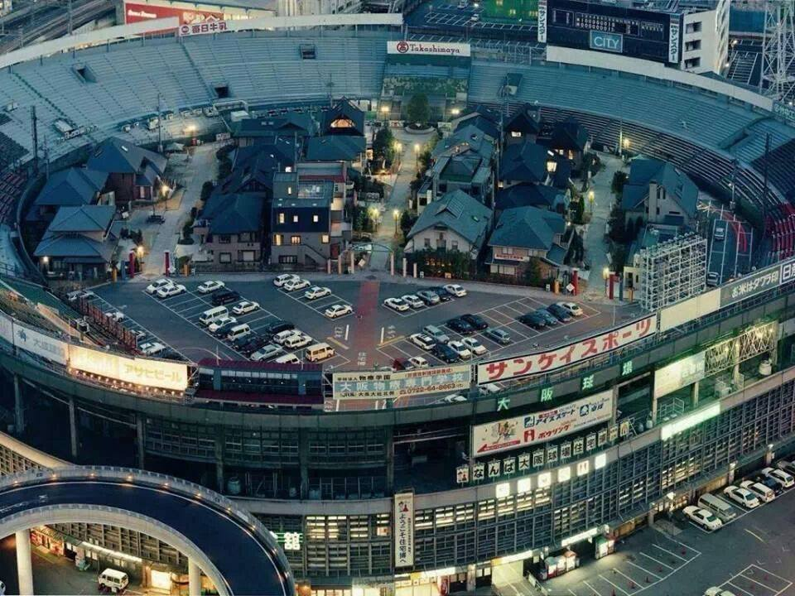

Slide 18
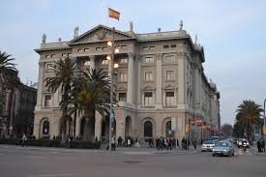
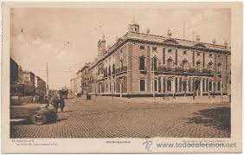
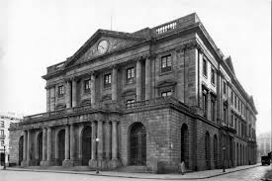
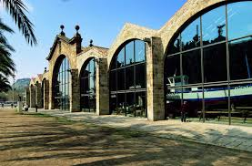

Slide 19
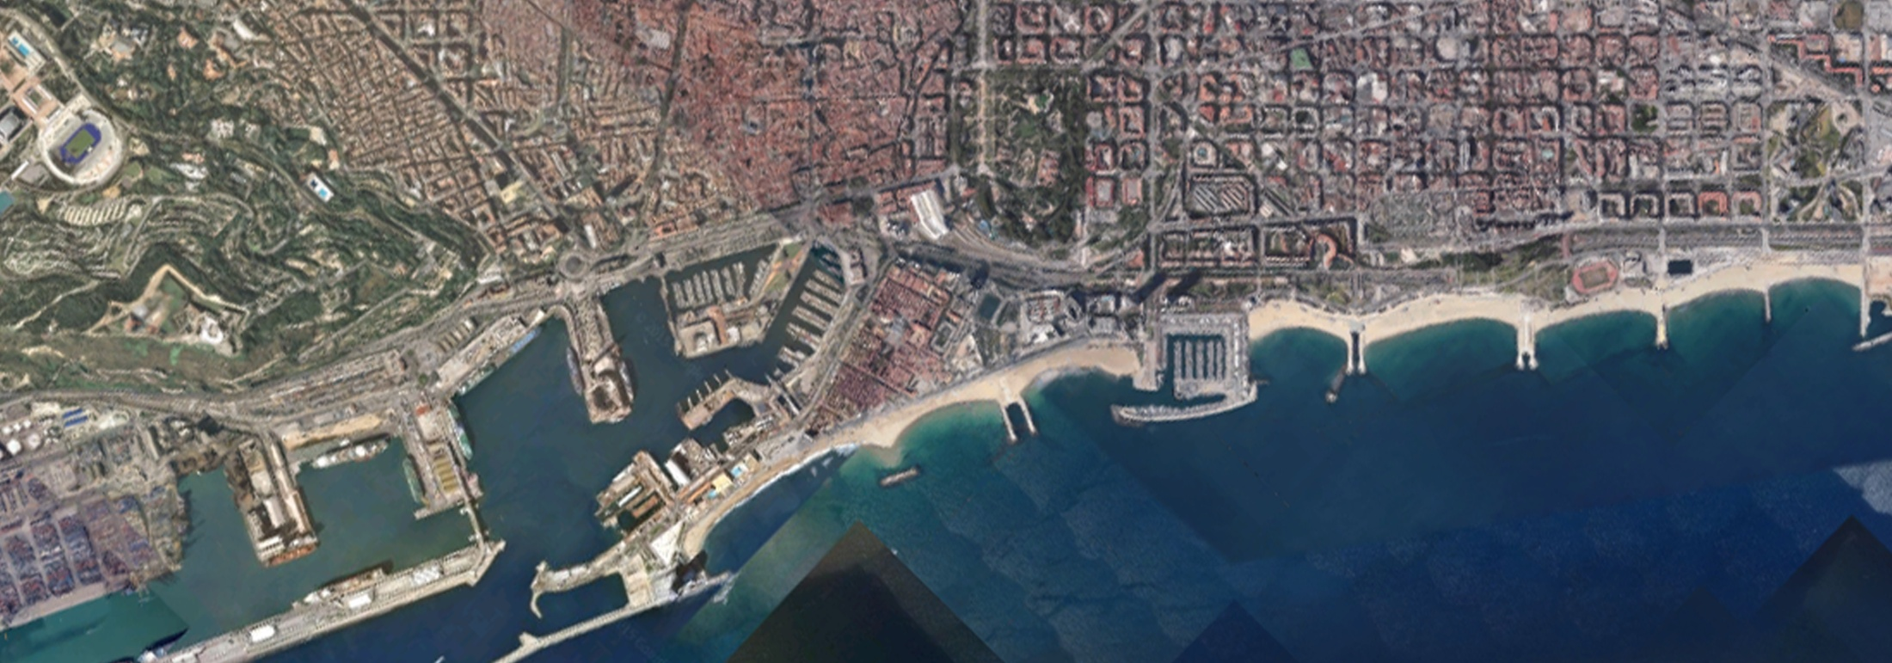
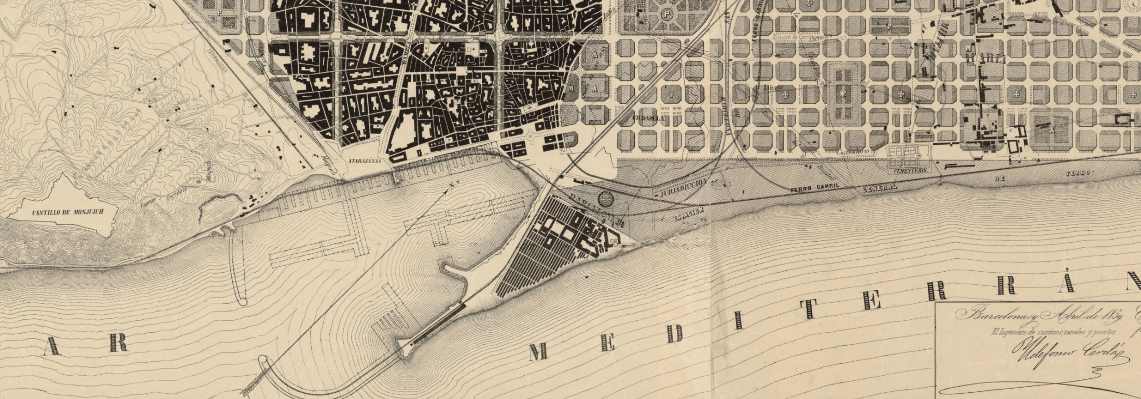
Barcelona 2015
Plànol I. Cerdà 1859

Slide 20
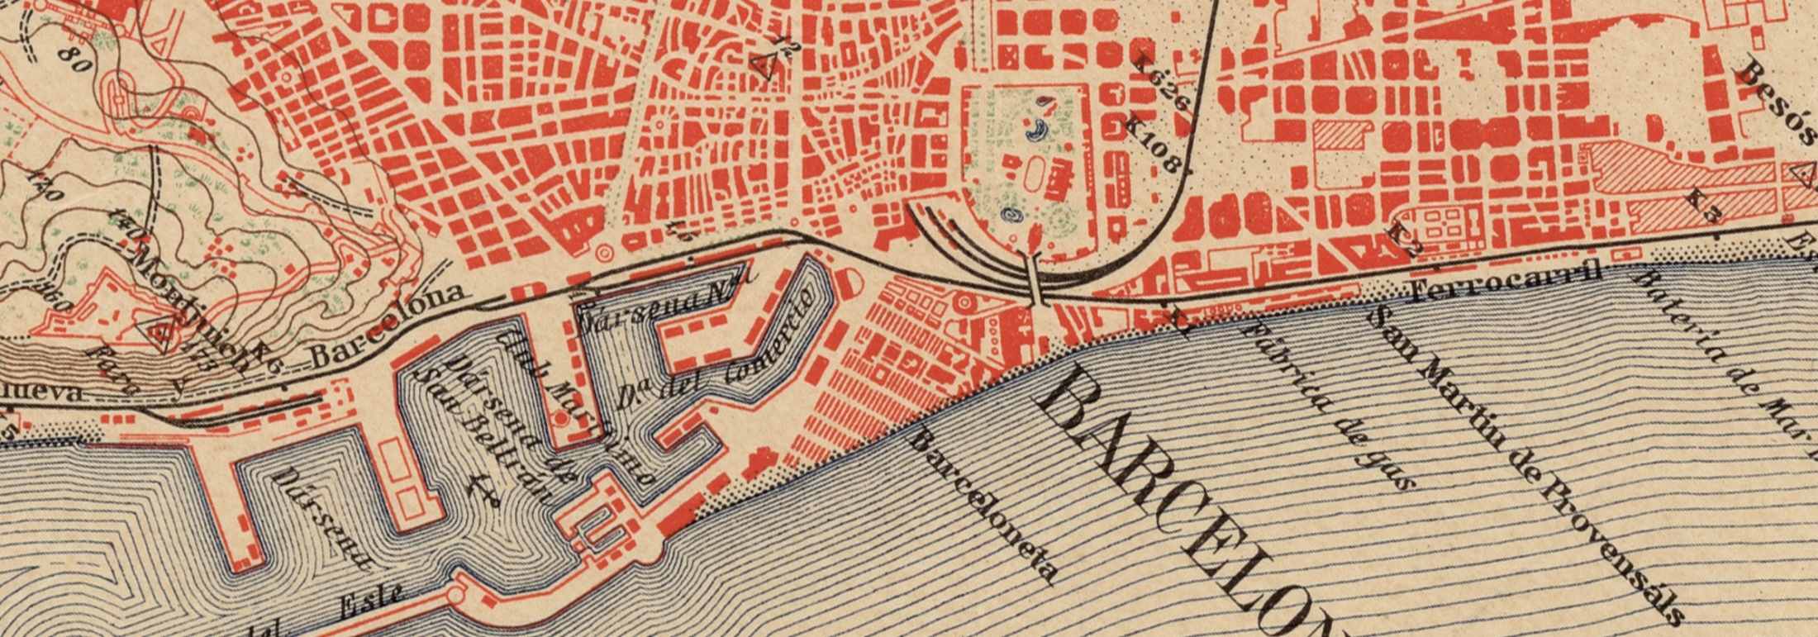
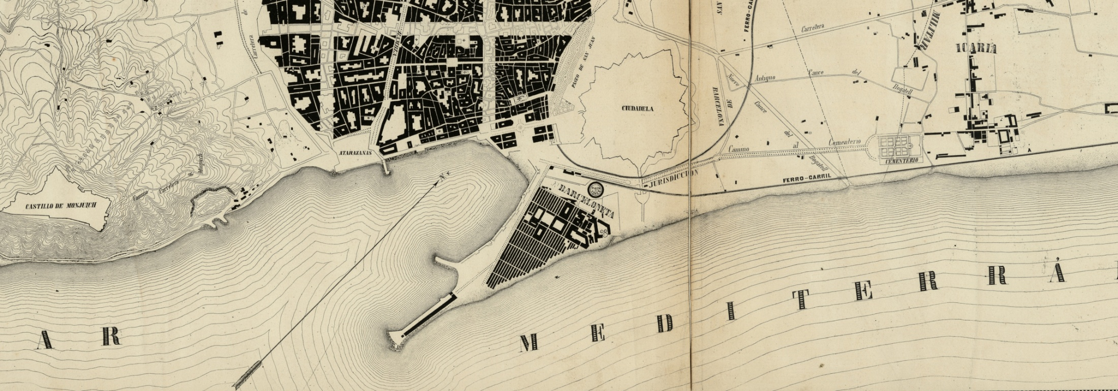
Barcelona 1925
Plànol I. Cerdà 1861

Slide 21
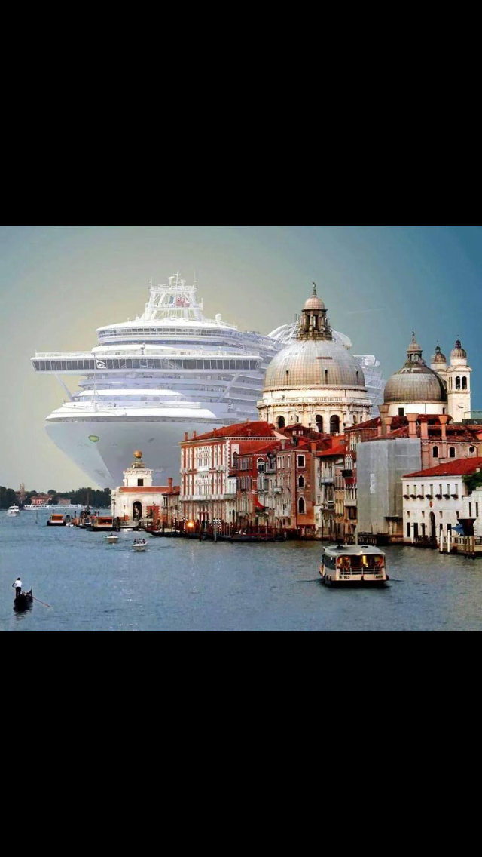

Slide 22
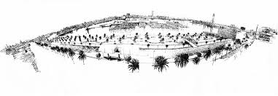
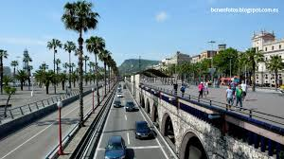
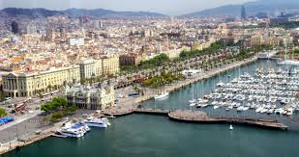

Slide 23
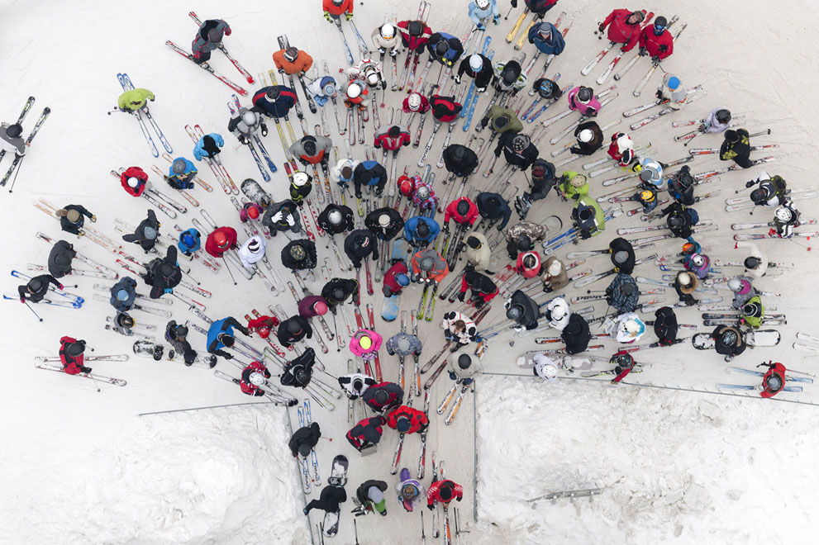

Slide 24
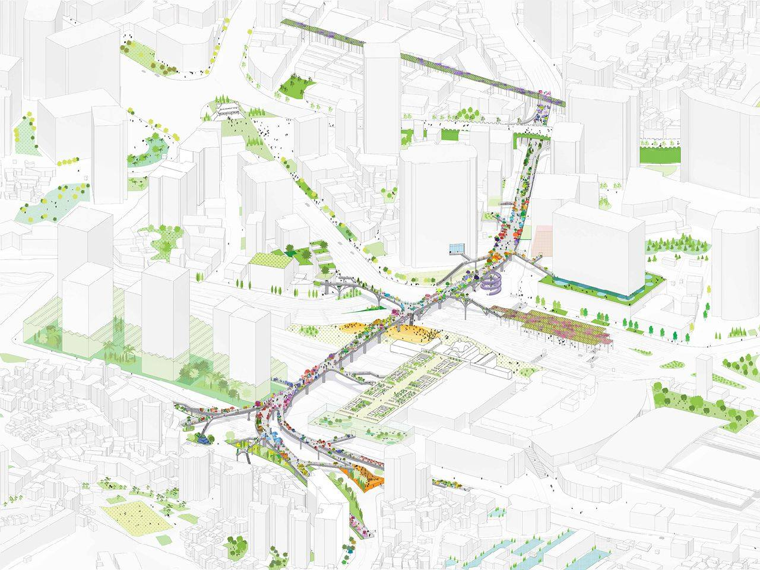

Slide 25
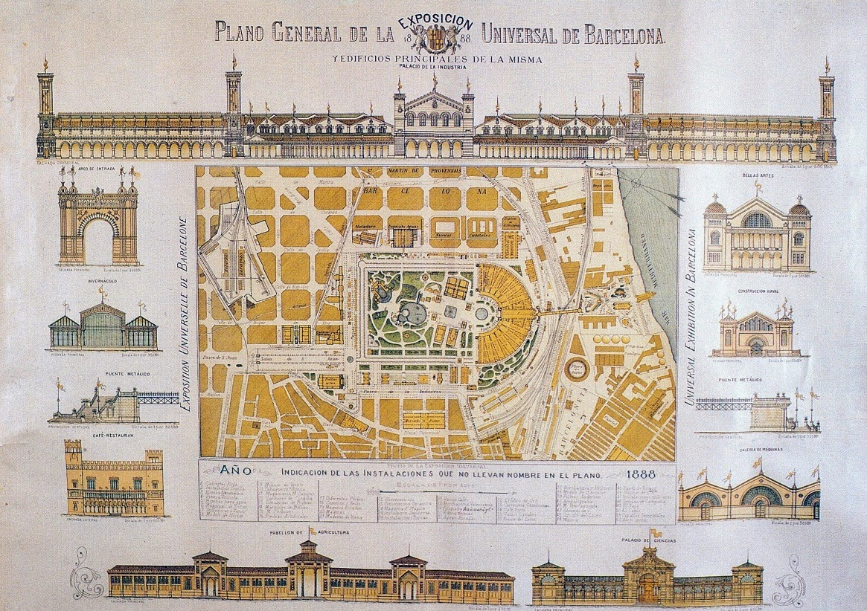

Slide 26
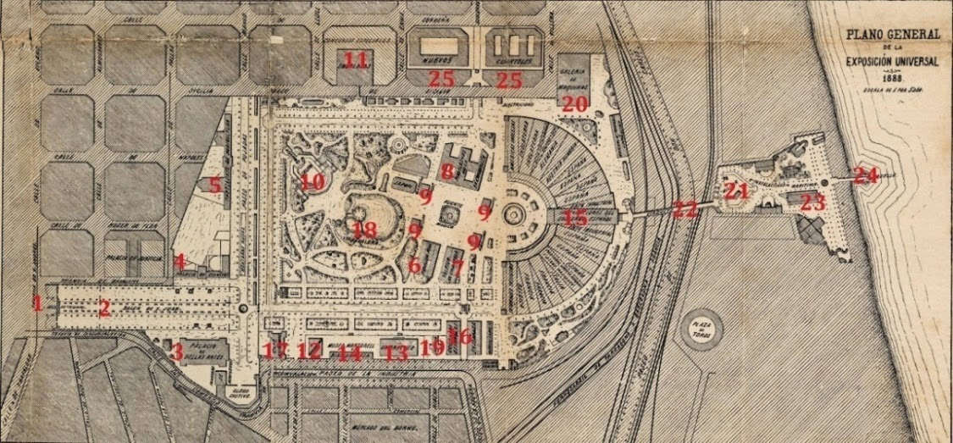

Slide 27
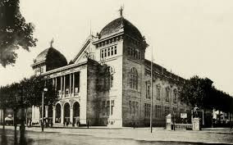
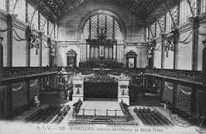
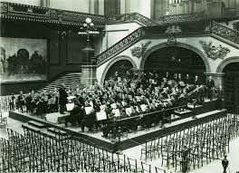
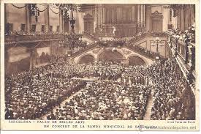

Slide 28
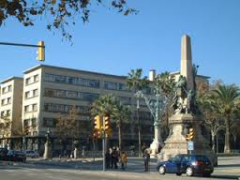

Slide 29
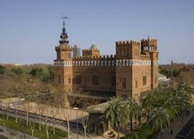
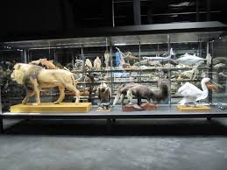

Slide 30
tap PUc
2015-2016
Quadrimestre primavera
Escola Tècnica Superior Arquitectura del Vallès
Universitat Politècnica de Catalunya
La ciutat adaptable
Regeneració d’arquitectures
Professors quatrimestre primavera: Franc Fernández, Carles Llop, Rosa Rull, Catalina Salvà
http://tapf.50webs.com/
Refs:
THE EUROPAN 13 TOPIC: "THE ADAPTABLE CITY“
www.europan-europe.eu/
Un bâtiment, combien de vies ?
La transformation comme acte de création
Carme Garau, arquitecta col.laboradora

